Slide 1


Microsoft Ignite 2019 Microsoft 365 Roadmap Slide Summary
Compiled by Susan Hanley
@susanhanley
www.susanhanley.com
sue@susanhanley.com
Updated: 18 November 2019

Slide 2
'Knowledge' inc. Project Cortex
Blog Post: https://techcommunity.microsoft.com/t5/Microsoft-365-Blog/Introducing-Project-Cortex/ba-p/966091
Project Cortex Resource Center: https://resources.techcommunity.microsoft.com/project-cortex-microsoft-365/
Available soon
Early next year
Top of mind
Microsoft Search in SharePoint & OneDrive
Content Connectors
Public previews of search connectors
Search extensibility
Custom search results page, query alterations
Modern Managed Metadata
Termsets increased to 1 million
Modern MMS admin UX Project Cortex v1
Taxonomy
Microsoft 365 suite wide experiences for taxonomy management, improved end user controls, term store usage analytics. Improved enterprise content type creation & management
Topic cards & pages
Mining of knowledge, topic card in search, feedback of knowledge system, knowledge focused web parts, compliance with info barriers
Content understanding
Content center, including forms processing with AI Builder + custom PowerAutomate template, Machine Teaching, smart ingestion of PDFs and better OCR
Microsoft Search in SharePoint & OneDrive Classic Sites get Microsoft Search
Scoping controls in search box
Custom query suggestions
Video vertical (Stream +ODSP)
Conversations vertical
Video & audio transcription including within Microsoft Word
Project Cortex v2
Topic cards & pages Further Microsoft 365 integration, more topic types, mapping across metadata types, increase scope of sources including taxonomy and machine teaching
Enhanced business process automation in content center
File viewers and annotation, deeper integration with information protection e.g. Auto-classification use of retention label
3rd Party Extensibility and APIs
Smart document creation & generation
Microsoft Search in SharePoint & OneDrive
Advanced search & extensibility, including Azure Search integration, better use of metadata and attaching workflow to metadata
Available soon
Ships to TR by 12/31/19
Must be in SOY Roadmap
Must be in MSRR
Early next year
Must ship before SPC (5/19/20)
Must be in SOY Roadmap
Must be in MSRR
Top of mind
Must be approved by GPMs & PMMs
Must be in SOY Roadmap
Must be in MSRR if work is being done

Slide 3

Intelligent intranet
Blog post: https://techcommunity.microsoft.com/t5/Microsoft-SharePoint-Blog/The-intelligent-intranet-powered-by-Microsoft-365-Microsoft/ba-p/975037
https://myignite.techcommunity.microsoft.com/sessions/81511
Available soon
Early next year
Top of mind
Home sites for web and mobile
Audience targeting for news and pages
Hubs
Hub join approval
Bulk hub association in admin center (available now)
Branding
Shy header
Additional footer capabilities
SharePoint mobile app co-branding
Pages, news and web parts
Wiki Linking
Undo/Redo
Available Now
Vertical sections
Drag and drop files to the canvas
Rich preview of links pasted into the text part
On page anchors
Button, Call to action, Clock & Weather web parts
Hero gets secondary call to action links
Highlighted content gets custom query filtering
Other key features
Make a classic team site a comm site
Site scripts & site designs: Extract a site to a site script, including multiple lists, branding and navigation (using PowerShell)
Page Diagnostics V2 for Modern (Released)
Page scheduling
Audience targeting for navigation
Multilingual publishing
Hubs
Associated hubs
Hub permissions
Hub analytics
Branding
Microsoft Fluent Design Language
Additional header capabilities
SharePoint Teal default theme
File uploads in SP mobile app
Portal owner page
Pages, news and web parts
Image resizing
Visual page diffing and version history
News filtering across sites with managed metadata
Yammer conversations web part (v2)
My Feed web part
Site scripts & site designs
Support for folder and file content
Teams template integration
Additional script actions
SharePoint spaces public preview
Global tenant navigation
Further integrations into Microsoft Teams
Calendar experiences in SharePoint

Slide 4

SharePoint team collaboration
Available now
Available Soon
Top of mind
First run and tips and tricks help for team site owners
Hub join approval
Teams: Channel files experience
Teams: Channel folder coupling
Teams: Shared ‘Sharing’ dialog
Extract a site to a site design, including multiple lists, branding and navigation (using PowerShell)
Planner cards in site activity
Team Site Modernize
Teams: SharePoint tab improvements for pages and lists
Teams: New ‘Add Teams’ experience
2019

Slide 5
SharePoint Lists and Libraries
Available soon
Early Next Year
Top of mind
Collapse/Expand button
Show/Hide/Reorder in SP Forms
PowerApps forms in document libraries
Conditional formatting rule builder UI
Conditional formatting rich text capabilities
Alternate row view formatting
Column Totals – Configure from Modern UI
Dynamic filtering in list web part
New List from Excel
Modern rich text editing in multi-line fields
Improved picture fields
Conditional show/hide in SP forms
Card view designer
Client performance + Large Lists
New List from Existing includes Flow + PA
More list creation options + templates
More SP Form customizability + seamless transition to PowerApps
More and more quick edit improvements
@mentions inside lists
More OOTB view types: Calendar, Kanban,
Deeper Teams integration
Blog post: Content collaboration throughout Microsoft 365 https://techcommunity.microsoft.com/t5/Microsoft-SharePoint-Blog/Content-collaboration-throughout-Microsoft-365-Ignite-2019/ba-p/960868

Slide 6
SharePoint BizApps
Available soon
Early next year
Top of mind
Custom forms for document libraries
Run manual flows on folders and document sets in lists and libraries
SharePoint Flow/PowerApps integration for GCC/GCC High environments
Support for DateTime delegation in PowerApps
Support for flows and custom forms in the new Create List from List experience
Create files in lists and libraries from PowerApps
Support for chunked uploads in Flows
Provision flows and custom forms for lists and libraries in Site Designs
Improved support for SharePoint column types
Granular SharePoint triggers – When a column value changes
Responsive custom forms
Integrate Flow and Custom Forms experiences within Teams for lists and libraries

Slide 7
Combined: SharePoint Business Apps and Lists
Available soon
Early next year
Top of mind
Power Apps/ Power Automate
Custom forms for document libraries
Run manual flows on folders and document sets in lists and libraries Lists
Collapse/Expand button
Show/Hide/Reorder in SP Forms
PowerApps forms in document libraries
Conditional formatting rule builder UI
Conditional formatting rich text capabilities
Alternate row view formatting
Column Totals – Configure from Modern UI
Dynamic filtering in list web part
Power Apps/ Power Automate
SharePoint Flow/PowerApps integration for GCC/GCC High environments
Support for DateTime delegation in PowerApps
Support for flows and custom forms in the new Create List from List experience
Lists
New List from Excel
Modern rich text editing in multi-line fields
Improved picture fields
Conditional show/hide in SP forms
Card View Designer
Power Apps/ Power Automate
Create files in lists and libraries from PowerApps
Support for chunked uploads in Flows
Provision flows and custom forms in Site Designs
Improved support for SharePoint column types
Granular SharePoint triggers – When a column value changes
Integrate Flow and Custom Forms experiences within Teams for lists and libraries
Lists
More SP Form customizability + seamless transition to PowerApps
More and more quick edit improvements
@mentions inside lists
More OOTB view types: Card, Calendar, Kanban,
Deeper Teams integration
More list creation options + templates

Slide 8

OneDrive
Blog post: https://techcommunity.microsoft.com/t5/Microsoft-OneDrive-Blog/Celebrating-top-OneDrive-moments-at-Ignite-2019/ba-p/963182
Delivered since SPC
Available soon
Top of mind @ Ignite
File card (time to read, insights)
Comments (non-Office files)
360° image and AutoCAD previewer
Password-protected links
External Sharing Reports
Updated design for iOS app
Updated recent view and UI for PDF annotations
New files experience (Outlook iOS)
Virtual Desktop Support
Per machine install (sync client)
Differential Sync
Direct links to individual PowerPoint slide
Popular Around Me
B2B sync (Sharing now in preview)
Cross volume sync in PC folder backup (KFM)
File card (conversations)
New files experience in Teams
New file sharing experience in Teams
Save for later
Expiring access for external users
@mention email notifications include Office comments
Recommended view on web
OneNote migration via PC folder backup (KFM)
Continuing sharing improvements
Block download for non-office files (Available soon)
Request Files (Rolling out)
Migration with Mover
100 GB file upload size (Rolling out)
Sync health reporting
Add to OneDrive
2019

Slide 9
External Sharing
What’s New for End Users
What’s New for Admins
Sharing integration in Microsoft Teams & Outlook
Sharing links that block download
Request files
Get link to PowerPoint slide
Reply to Office comments from Outlook
Address bar sharing
Sync across organizations
Password protected Anyone links
External users in file View counts
Comments on all file types
Save for Later
@mentions in Office comments
Mute notifications on specific files
Popular Around Me
Inherited Links Banner in Manage Access
Sharing Reports
Expiring external access
Azure B2B Integration in Preview
Per-Site Anyone Link Expiration
Default Sharing Link to People with Existing Access
New Site Collection Sharing Settings Panel for Modern SharePoint Admin Center
Modern Site Sharing Settings Experience
Custom IT Help Link for External Sharing
Productivity Score for Admins
BRK3263: showcases all the new and “coming soon” features for external sharing: https://myignite.techcommunity.microsoft.com/sessions/81495?source=sessions

Slide 10
SharePoint Developer platform
Available soon
Early next year
Top of mind
SharePoint Framework
Pre-allocated headers
Support for Teams personal apps
Support for Teams mobile app
Query Extensions (dev preview)
Support for Office add-ins in OWA (dev preview)
Fluid Components support (Private Preview)
Graph
Webhook support for Lists
Permission change support for Delta API
Followed Sites API (Dev Preview)
Check in \ Check out (Dev Preview)
SharePoint Framework
SPFx solutions in AppSource
GA of Query Extensions
Nav and header extensions (dev preview)
Graph
Site Discover\Enumeration API
File Requests Sharing API
Taxonomy API (dev preview)
Hub Analytics API (Dev Preview)
SharePoint Framework
Unified toolchain for Microsoft 365 workloads
Support for Fluid Components
Graph
CSOM on .NET Code

Slide 11
SharePoint Site Analytics and Intelligence
Available soon
Early next year
Top of mind
Item Recommendations
People like a page
See the number of people who like a page
Comments on a page
See the number of comments on a page
Management read this
Understand who read this in the organization
Site Analytics
Active time spent reports
Cumulative hub analytics
Download usage data in excel
Item Recommendations
Recommendation Reasons
Topic Information
See pages about similar topics
More from Page Author
Tenant Controls
Feedback <Signals vs. Mechanism>
Recommended Settings

Slide 12
Roadmap: Security & Compliance
Available soon
Early next year
Top of mind
Sensitivity Labels
Sensitivity labels for Sites and Office 365 Groups (Public Preview)
Sensitivity labels with Protection for Files (Public Preview)
SPO Auto Classification with Sensitivity Labels
(Private Preview)
Policies
Automatic expiration of external user access (GA)
DLP block external access by default for SharePoint (GA)
Compliance
Information Barriers (Private Preview)
Sign-up for private previews at: https://aka.ms/ODSPSecurityPreviews
Learn more at: https://aka.ms/ODSPSecurity19
DLP block anonymous access for sensitive files (GA)
Sensitivity labels for Sites and Office 365 Groups (GA)
Sensitivity labels with Protection for Files (GA)
SPO Auto Classification with Sensitivity Labels (GA)
Granular conditional access at site level with MFA (Multi-factor-authentication)
Office 365 unified instant access revocation
Conditional access for Office 365 App Group

Slide 13
SharePoint and OneDrive Admin
Available Soon
Next Year
Top of mind
SharePoint Admin UX
Advanced sharing settings
In the Active Sites page
Change Site URL Available now
Replace Root site in PowerShell now
New site panels
General, Activity, Permissions and Policies
Bulk operations
hub site association, Sharing and Delete
Settings page
Updated settings page
Left Nav
Customizable and collapsible Left Nav
Customizable Home page
A modern dashboard with customizable cards
Global Reader Role
Read only role in SharePoint admin center
Productivity and Network score
A dedicated score to track productivity
SharePoint migration center
Orchestrating large migrations of files
Content Services admin
Term store New Terms Store admin
Content Type New Content Type gallery
Analytics New Terms and Content type insights
Retire the classic admin
Modernize the remaining admin experiences

Slide 14
Migration
Ignite session links: BRK3006-Migration to SharePoint, OneDrive, and Microsoft Teams in Microsoft 365, free and easy https://myignite.techcommunity.microsoft.com/sessions/81518?source=sessions
2019
2020
Top of mind
SharePoint Migration Tool
SharePoint 2010 site migration
SharePoint 2013 site migration
Target folder/channel selection
Migration Manager
Orchestrating large file share migrations (Public Preview)
Cloud Migrations
Self-serve migration from Box, Dropbox, Google Drive, Egnyte
North American customers only
SharePoint Migration Tool
SharePoint 2016/2019
Migration Manager
File share migration (GA)
SharePoint on-premises
Cloud Migrations
Self-serve migration available for all customers
SharePoint Migration Tool
Continued investments in on-premises scenarios
Migration Manager
Parity with SPTM
Cloud Migrations
Integrating cloud migration scenarios

Slide 15
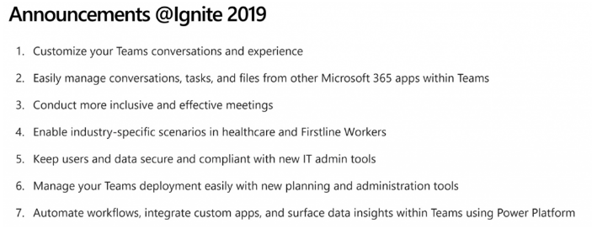
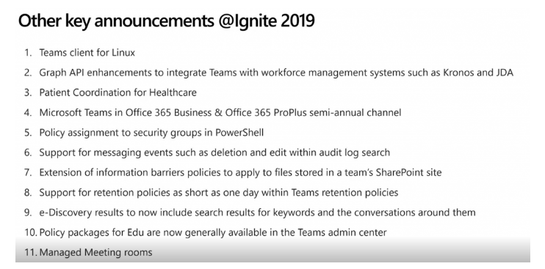
Teams
Summary from @xGokan (Gokan Ozcifci)
http://gokan.ms/directly-from-ignite-2019-all-that-you-need-to-know-about-the-new-roadmap-features-of-microsoft-teams/
Blog post: What’s New in Microsoft Teams | Ignite 2019 https://techcommunity.microsoft.com/t5/Microsoft-Teams-Blog/What-s-New-in-Microsoft-Teams-Ignite-2019/ba-p/937025

Slide 16
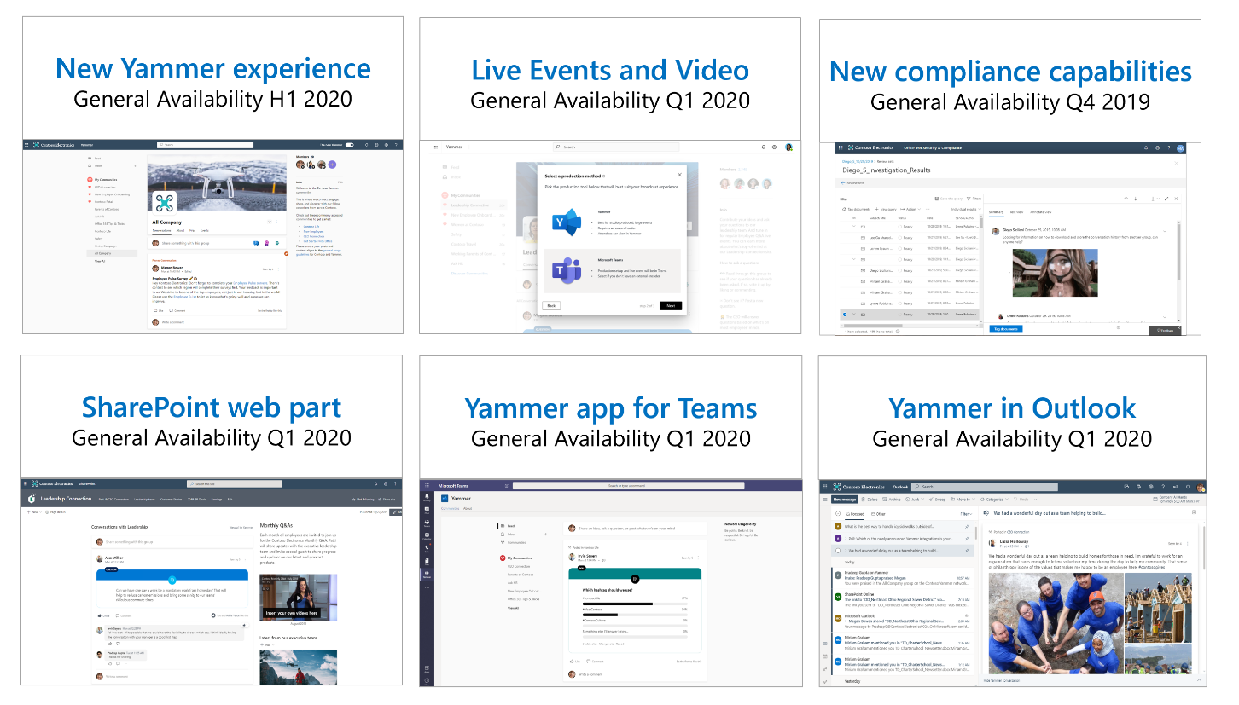
Yammer Roadmap

Slide 17
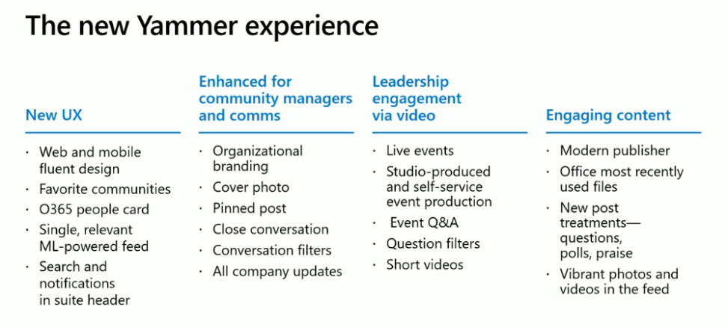
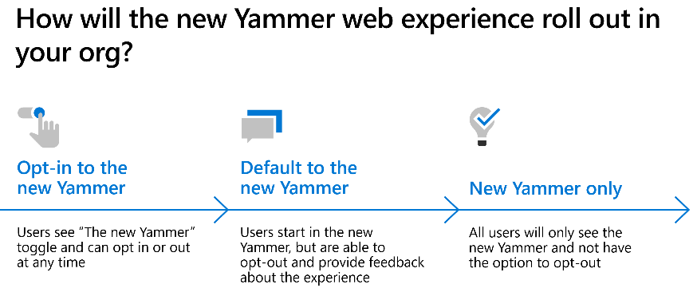
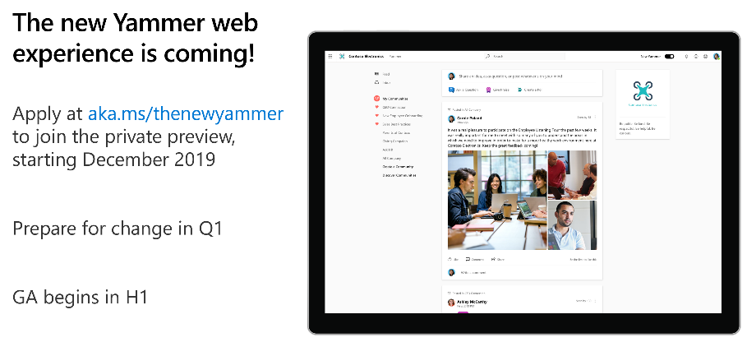
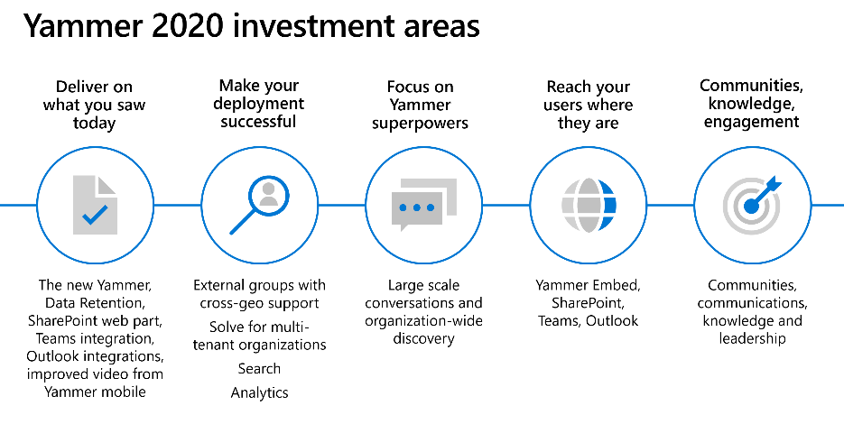
The New Yammer
Blog Posts:
https://techcommunity.microsoft.com/t5/Yammer-Blog/The-Future-of-Yammer-Microsoft-Ignite-2019/ba-p/976710
https://techcommunity.microsoft.com/t5/Yammer-Blog/The-New-Yammer/ba-p/976855
https://techcommunity.microsoft.com/t5/Yammer-Blog/Yammer-powers-organizational-IQ-through-new-knowledge/ba-p/976752

Slide 18
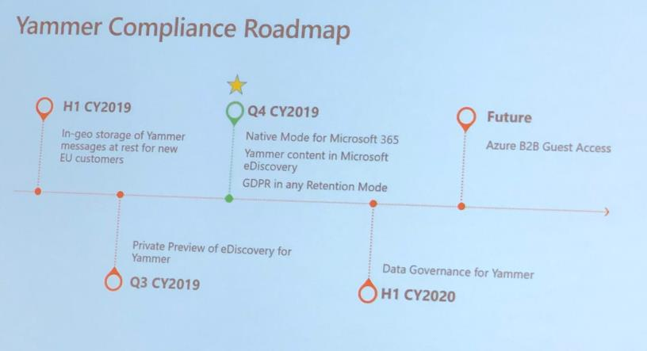
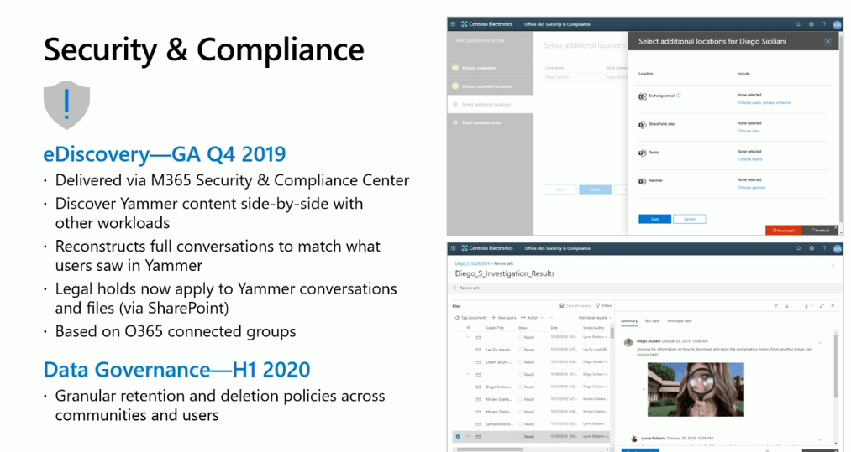
Yammer Compliance

Slide 19
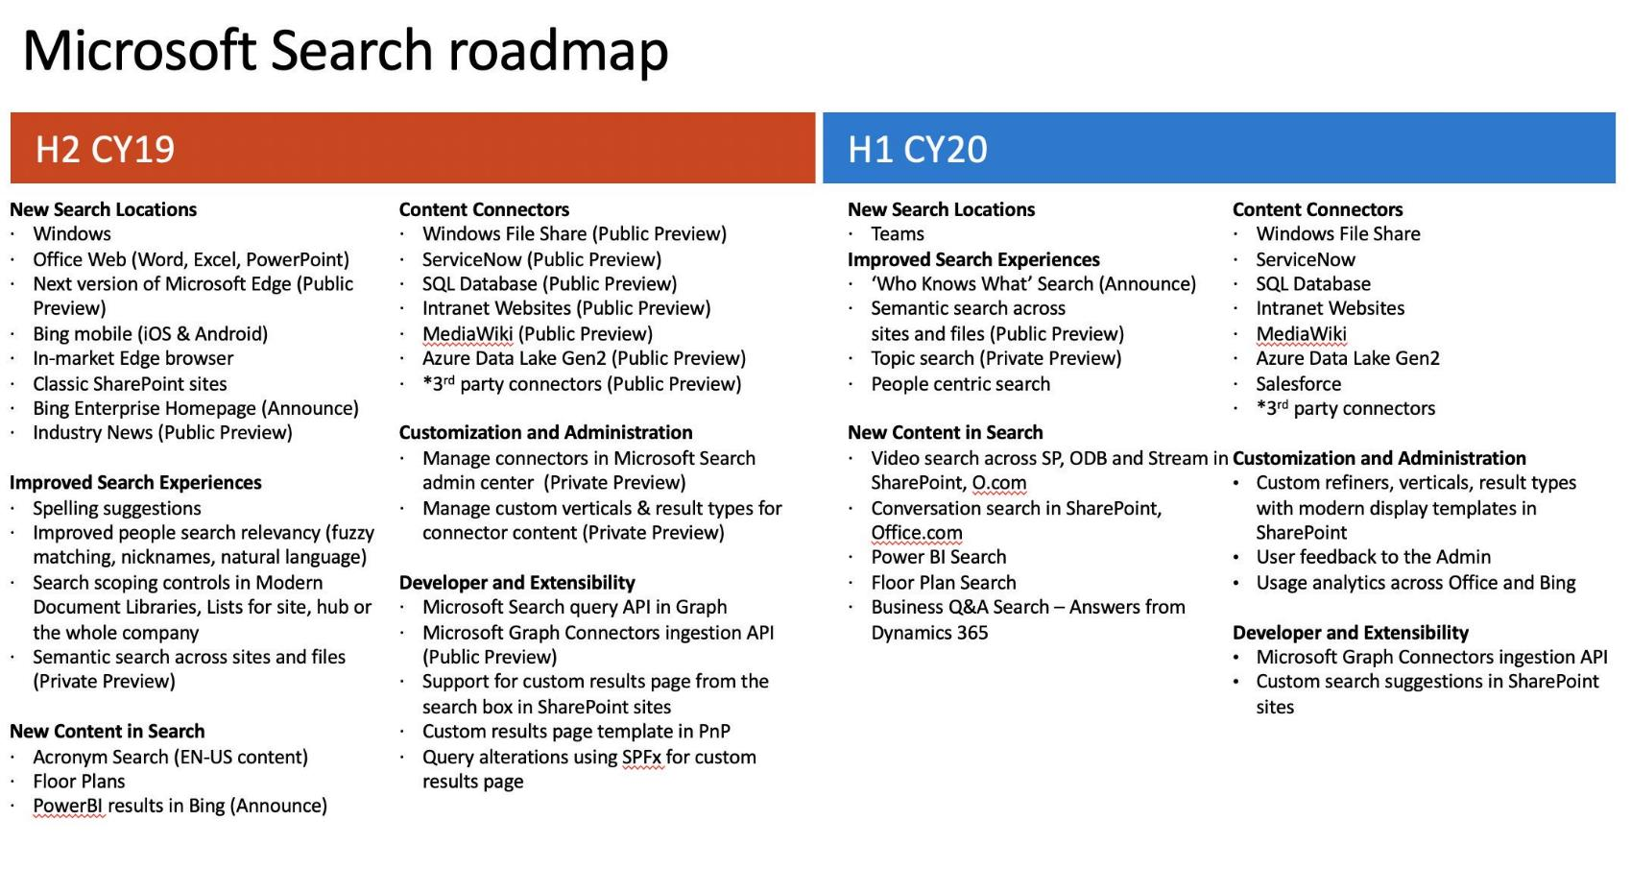
Search
Search: What’s New and What’s Next: https://myignite.techcommunity.microsoft.com/sessions/81153?source=sessions

Slide 20
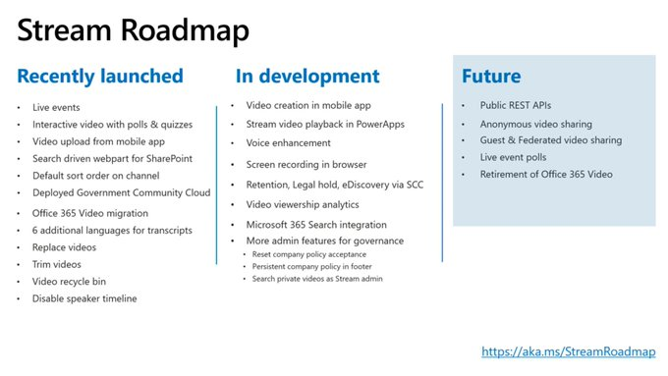
Stream

Slide 21
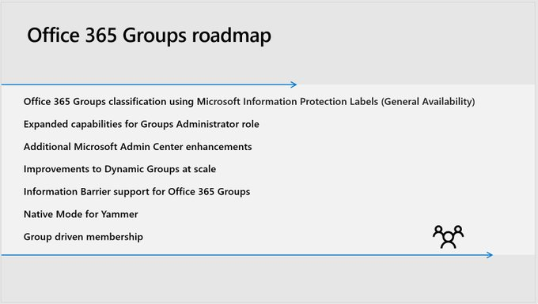
Office365 Groups Roadmap

Slide 22
OneNote Roadmap
Modern services
Section sharing
@
@mentions
Tasks
Microsoft Search
Accessibility
Meeting notes
Next gen canvas

Slide 23
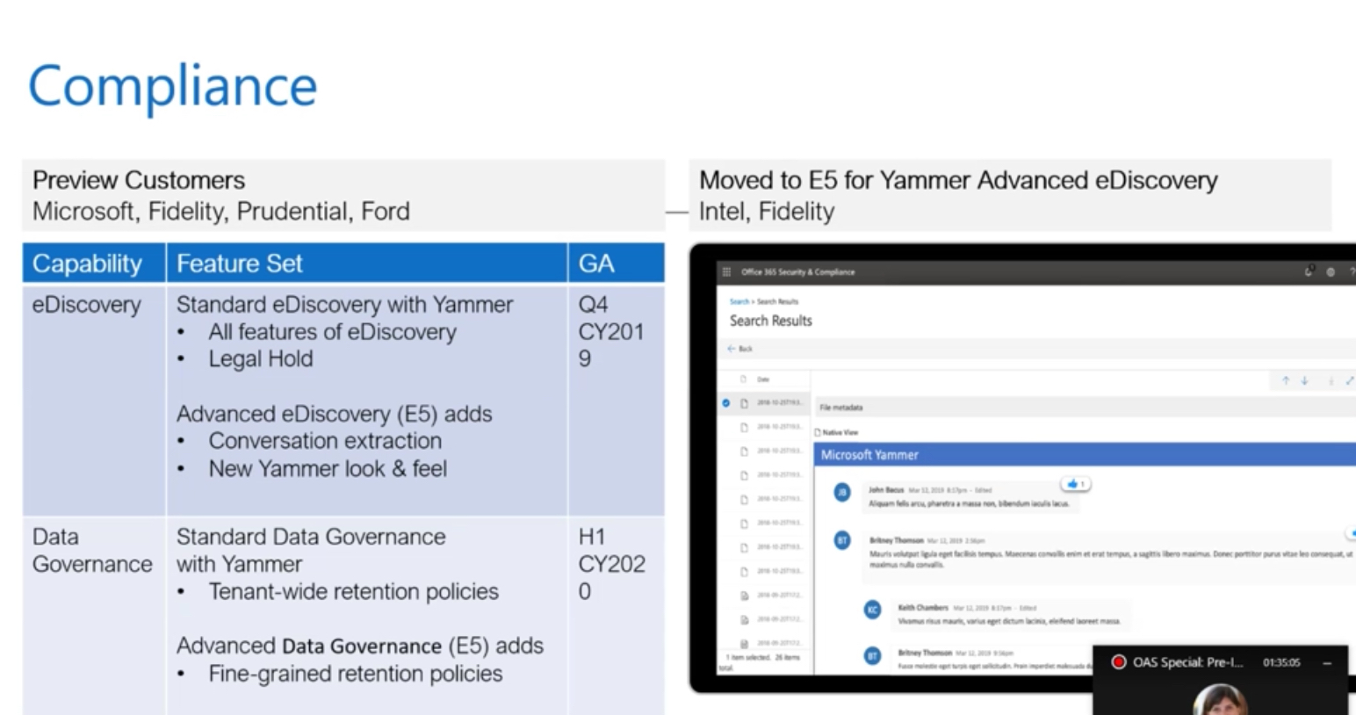
Compliance

